Slide 1

Implement Virtual Networking
Virtual networks and virtual network peering

Slide 2
Learning Objectives
You will learn the following concepts:
Virtual Networking
Virtual network Peering
Implement VNet Peering

Slide 3

Virtual Networking

Slide 4
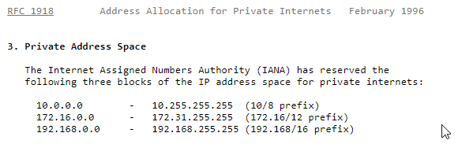
Azure Virtual Networking (1 of 3)
Virtual network concepts:
Address space
Subnets
Regions
Subscription
Best practices:
Ensure non-overlapping address spaces
Don’t cover the entire VNet address space
Configure a few larger VNets (rather than many small ones)
Secure VNets by assigning NSGs to subnets

Slide 5
Azure Virtual Networking (2 of 3)
Communicate with the Internet:
Outbound traffic is allowed by default
Inbound traffic can be provided via:
A public IP address
A public load balancer
Communicate between Azure resources:
Through a virtual network
Through a virtual network service endpoint and/or private endpoint
Through VNet Peering
Communicate with on-premises resources:
Point-to-site VPN
Site-to-site VPN
Azure ExpressRoute

Slide 6
Azure Virtual Networking (3 of 3)
Filter network traffic:
Network Security groups
Network virtual appliances
Route network traffic:
Route tables
BGP routes
Virtual network integration for Azure services:
Deploy dedicated instances of the service into a VNet
Use Private Link
Use service endpoints
Notes:
The key difference between Private Link and Service Endpoints is that with Private Link you are injecting the multi-tenant PaaS resource into your virtual network. With Service Endpoints, traffic still left you vNet and hit the public endpoint of the PaaS resource, with Private Link the PaaS resource sits within your vNet and gets a private IP on your vNet. When you send traffic to the PaaS resource, it does not leave the virtual network.

Slide 7
Comparison of Virtual Network Peering and VPN Gateways (1 of 2)
Virtual Network peering and VPN gateways support connecting:
Virtual networks in different regions
Virtual networks in different Azure Active Directory tenants
Virtual networks in different Azure subscriptions
Virtual networks that use a mix of Azure deployment models

Slide 8
Comparison of Virtual Network Peering and VPN Gateways (2 of 2)
Item | Virtual network peering | VPN Gateway
Limits | Up to 500 per VNet | One per VNet (per gateway limits are SKU-dependent)
Pricing model | Ingress/Egress | Hourly + Egress
Encryption | Not included | IPsec/IKE
Bandwidth | No limits | SKU-dependent
Public endpoints | No | Yes
Transitivity | No | Yes (routing dependent)
Initial setup time | Fast | ~30 minutes
Typical scenarios | Data replication, database failover, and other scenarios needing frequent backups of large data. | Encryption-specific scenarios that are not latency sensitive and do not need high throughout.

Slide 9
Choose Between Virtual Network Peering and VPN Gateways
Virtual Network peering:
Direct (no interconnecting devices)
Low-latency, high-bandwidth
Regional or global
VPN gateways:
Serve as interconnecting devices
Introduce extra latency and limit bandwidth
Gateway transit:
Allows sharing a VPN or ExpressRoute gateway across a peering
Minimizes complexity and centralizes management

Slide 10
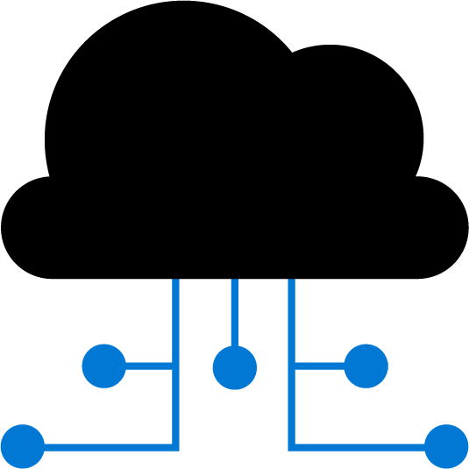
Virtual Network Peering

Slide 11
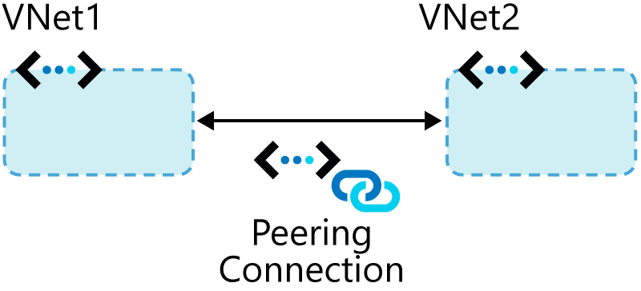
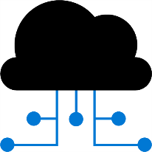
Connect Services with Virtual Network Peering (1 of 2)

Slide 12
Connect Services with Virtual Network Peering (2 of 2)
Types of peering connections:
Virtual network peering
Global virtual network peering
Peering considerations:
Reciprocal connections are required
Cross-subscription peerings are supported

Slide 13
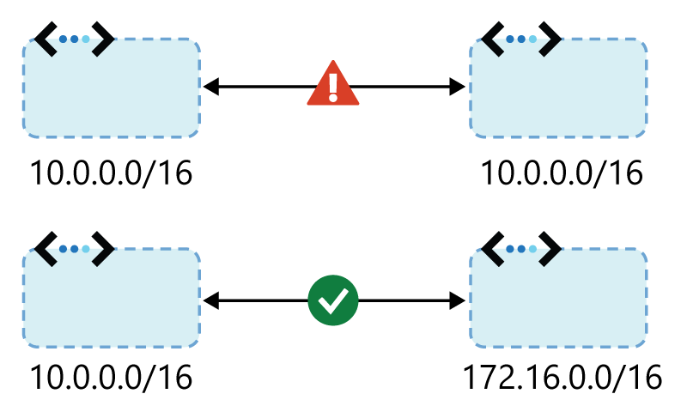
Transitivity and Gateway Transit
Virtual network peering is nontransitive
Gateway transit:
Facilitates cross-premises connectivity
Enable the Allow gateway transit option in the hub
Enable the Use remote gateways option on spoke
Peering considerations:
IP address spaces can’t overlap
Peering is the recommended option

Slide 14

Implement VNet Peering

Slide 15
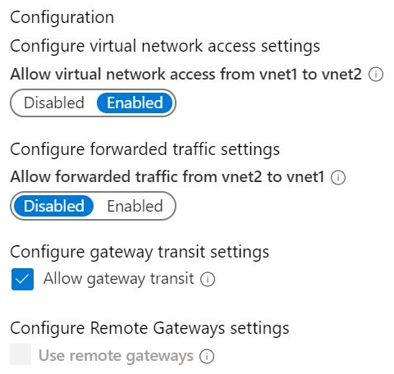
Configure VNet Peering
Configure VNet peering:
Create two virtual networks
Peer the virtual networks
Create virtual machines on each network
Test communication between the machines
Use the Add peering blade to configure peering:
Allow forwarded traffic
Allow gateway transit
Use remote gateways

Slide 16
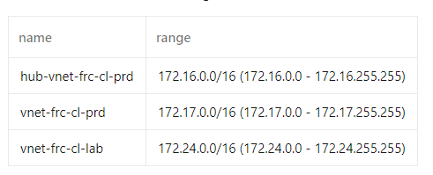
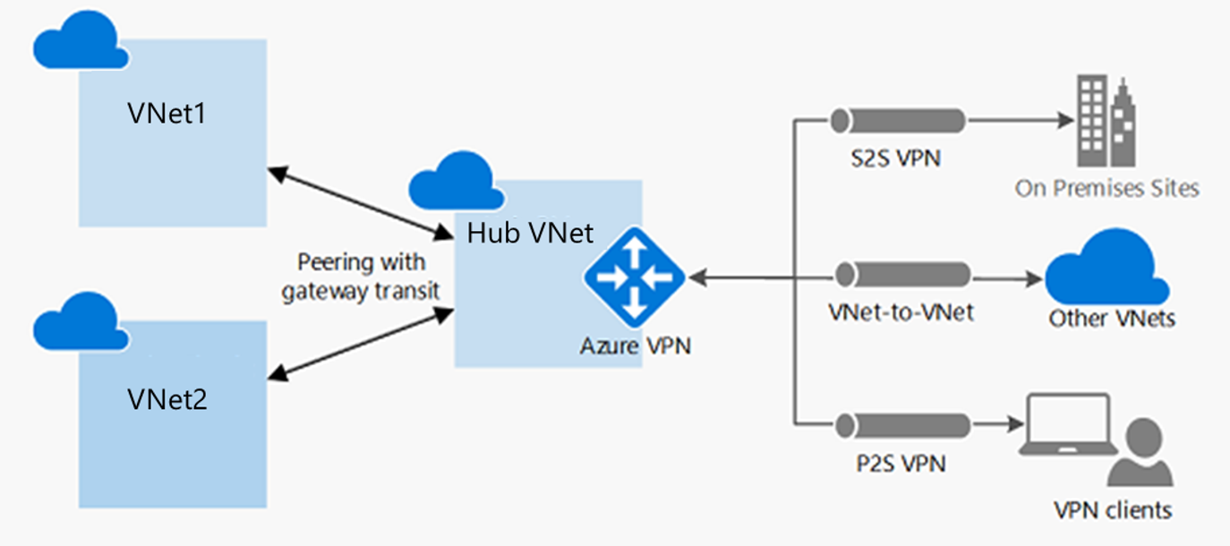

Service Chaining (1 of 2)
Hub and spoke architecture

Slide 17
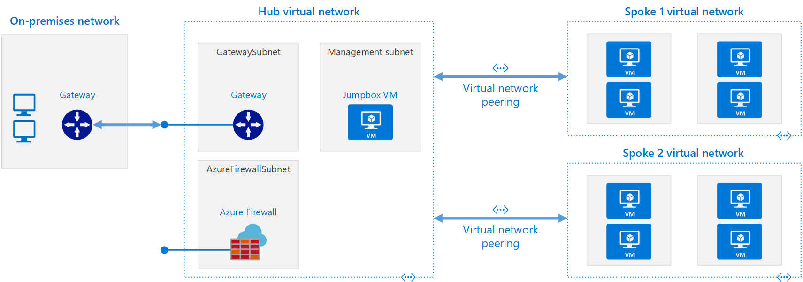
Service Chaining (1 of 2)
Hub and spoke architecture

Slide 18
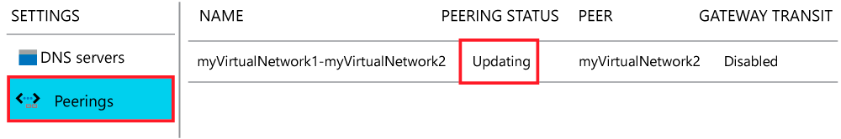
Service Chaining (2 of 2)
User defined routes and service chaining
Checking connectivity status:
Updating
Connected

Slide 19
Demonstration: VNet Peering
Configure VNet peering
Configure a VPN gateway
Allow gateway transit
Confirm VNet peering

Slide 20
Thanks!

